Slide 1
Entrepreneurial Leadership
ENT 107 Fall 2025
Class 9

Slide 2


ENT 107 Fall 2025 – Guest Speaker Line-up
Ivi Morales
bombilla
Tuesday, October 28
Ted Dillon
Clean Energy Ventures
Tuesday, November 28

Slide 3
Team projects - #7
Mindfulness

Slide 4
Our plan for today
GIVING
FEEDBACK
MANAGING CONFLICT
ON DECK –
Assignments and
next class

Slide 5
GIVING FEEDBACK

Slide 6
The feedback paradigm is shifting to more of an iterative vs. event based model
Companies like GE, Netflix and Adobe abandoned traditional performance reviews and instead engage in ongoing feedback conversations empowering employees to truly own their development and contribute on a bigger scale to the growth of their organization.
Feedback is more collaborative with employees at all levels seeking input and guidance and using that intel to affect real change.
In my own work as a manager at GE, I make it a regular practice to ask my colleagues to tell me something they think I don’t want to hear, and then I take action to address it and communicate back what has changed. It’s valuable not just because of the new information I learn, but because it reinforces a culture of openness.
Beth Comstock,
former Vice Chair, GE
Notes:
More and more companies are questioning the value of traditional performance review practices – the focus is more on development (coaching/mentoring) vs. bureaucratic evaluation.
Love this quote from GE’s SVP of Human Resources, Susan Peters: “The world isn’t really on an annual cycle any more for anything.”
More context in Fast Company’s, “The annual performance review is going extinct.” (https://www.fastcompany.com/3052135/why-the-annual-performance-review-is-going-extinct)

Slide 7
Honing feedback skills is more critical now than ever
Intuitively organizations know these conversations matter. Leaders want to grow and develop and they want those with whom they work to do the same.
Yet big mistakes happen all the time
  Feedback isn’t happening at all
  It’s not direct enough
  It’s not tied to something bigger
There are many variables at play – who’s delivering the feedback, who’s receiving, what messages are being conveyed, what’s at stake?
But - no matter the situation – there are foundational processes and approaches that can set us up for success

Slide 8
Everything is rooted in active listening
1

Slide 9
Active listening
Understanding not only the content of what others are saying, but also picking up the feelings behind the words that are being spoken.
Notes:
Use the HEAR model: Hear, Empathize, Analyze, Respond

Slide 10
Do as Pareto says … live by the 80/20 rule
2

Slide 11
PLANNING
EXECUTION
PLANNING
EXECUTION
EXECUTION
More planning → less wheel spinning!
Notes:
Planning as it relates to feedback conversations can entail:
Knowing what our triggers are and investing the time to develop skills needed so that we can fully receive feedback
Understanding how those with whom we work want to receive feedback and what their triggers might be (and what we can do to better frame our feedback so that it is effectively received)
Understanding the bigger picture – why the feedback you’re sharing is so important
And especially for the more formal conversations – investing the time in fully preparing (see steps listed on next slide)
Planning isn’t just about investing time – it’s about being thoughtful before you jump to conclusions.

Slide 12

Key planning steps when giving feedback
Collect your facts
Understand the root cause
Determine your goals
Draft your opening
Pick the right time and location
Anticipate reactions
Notes:
Collect your facts – may include interviewing others for information, observing firsthand, etc.
Understand the root cause of the situation/problem/challenge – is there something bigger that needs to be addressed?
Determine your goals for the feedback session – what’s the key message you’re intending to share, why does it matter, what do you hope to accomplish with the conversation you’ll have?
Draft your opening, objectives and time frame for completion
Pick the right time and location – where and when for optimal active listening and engagement? No interruptions, distractions
Anticipate reactions – what can you do ahead of feedback conversations to anticipate how someone will react to your feedback?

Slide 13
Lead with intent
3

Slide 14
“The reason I am telling you this is …. I am hoping the result of this conversation will be ….”
Notes:
The point of leading with intent is to make sure people know you are actually providing feedback (remembering that one of the biggest feedback mistakes that happens in the workplace is delivering feedback that is vague).
Set the stage for honest and productive feedback conversations.
Use language that feels comfortable to you.
If it’s more informal feedback – try asking something like, “I have some feedback to share about your presentation based on my observations from those in the audience – are you OK with me sharing this?”

Slide 15
Create context - think about why first
4

Slide 16
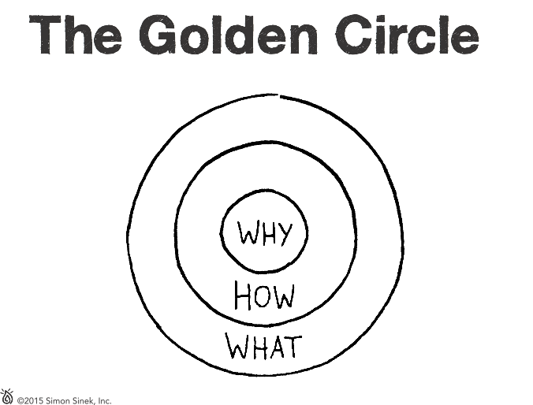
Help people understand why the feedback matters
Overarching needs, goals and challenges
Impact on the team
Expectations of role/critical skills to perform in the job
Notes:
State the impact of the behavior – on the team, the goal, the client relationship, etc.
Saying what the impact is allows the receiver of the feedback to better understand why they should change or at least consider the input.

Slide 17
Ask questions to understand and to be understood
5

Slide 18
Shed the notion that giving feedback means doing most or all of the talking
Listen!
Ask questions to clarify
Reflect
Show empathy
Notes:
Listen:
Provide some good ideas for solutions
Help de-fuse the other person’s anger and frustration – they may need to vent before they can turn to constructive problem solving – so let them, it should actually help
Surface misperceived aspects of the situation (and if that’s the case, better to listen and figure that out before you jump down someone’s throat mistakenly)
Ask questions to clarify or probe: helps you “look before you leap” to accuse someone of something. Helps keep the conversation focused on facts and from descending into accusations. Can be a good device to use if you’re giving feedback to someone who’s particularly sensitive at a given moment or in general. Turn your accusatory statements into questions and watch the results. For example, instead of saying, “I think that color blue is too loud and garish to use for our audience” say “Do you think that color blue is distinguished enough for our audience?”
Reflect: This does not mean sit back and think about things. It means play back to someone what they’re telling you so that they feel heard and understood. “So what I hear you saying is that you think …” or “Sounds like you’re pretty frustrated about what I’ve been telling our partner …” May sound forced but if reflecting can be done in a genuine fashion, it is a highly effective tool. Until people feel heard, they’re likely to keep hurling their emotion or their side of the story at you.
Show empathy: You can feel (or learn to feel) genuine empathy for someone even if you think they’ve done everything wrong. And if you can express that empathy, the other person will be able to get past their venting faster and on to problem solving. For example, “I know you worked until 2:00 AM last night and I appreciate that. You must be exhausted. Unfortunately, the presentation still doesn’t flow logically for me from slide to slide.”

Slide 19

Feedback Communication Skills
From: Gathering Constructive Feedback
 | What To Do… | What To Say…
ENCOURAGING | Use verbal and non-verbal prompts to keep the conversation flowing and to demonstrate interest in the other person’s response Empathize | Please say more about….. That’s a really good point I’m glad you brought this to my attention I can understand why you’d feel that way
QUESTIONING | Use closed and open-ended questions to explore the feedback or the situation from a number of perspectives. Inquire about the other person’s understanding of the feedback Ask for clarity and/or more detail | What happened from your perspective? I want to be sure I understand—can you give me more detail? What is it that you agree/disagree with about the feedback I’m sharing with you? What would be an example of….?
CONFIRMING | Use confirming to demonstrate to the other person that you have been listening and are aware of the facts and the emotions that are most important to them You might need to go back to questioning if your restatement leads to new information Empathize | What I hear you saying is… We’ve covered a lot of ground, the key points I remember are…. Am I missing anything?
PROVIDING | Use providing to state your feedback and any next steps in a clear, direct, non-defensive way Describe the facts, feelings and reasoning that led to your feedback Be mindful of your, and the others person’s, words, tone and body language when providing | Let me share with you what I observed and why I think it’s important that we talk about it. Here’s an example of what I mean…. In my experience, here’s what’s worked best…. I observed the following….
CHECKING | Use checking to verify the other person has understood your feedback, and that he/she is in agreement with it Use checking throughout the conversation as needed to check for agreement and understanding | Does that make sense? Would you agree that’s important? Are the next steps clear? Is this something you can do differently moving forward?

Slide 20
Think partnership vs. transaction
6

Slide 21
Practice same side feedback
Typically feedback is thought of as an issue between people …
“You are doing something wrong and I will tell you about it.”
Instead – think of feedback as we’re on the same side, sharing goals …
“Together we’ll figure out how you can succeed.”

Slide 22
Use a SMART framework when setting goals
Specific (simple, sensible, significant)
Measurable (meaningful, motivating)
Achievable (agreed, attainable)
Relevant (reasonable, realistic and resourced, results-based)
Time bound (time-based, time/cost limited, time-sensitive)
Notes:
SMART Goals
Specific
Well defined
Clear to anyone that has a basic knowledge of the project
Measurable
Know if the goal is obtainable and how far away completion is
Find out when you have achieved your goal
Agreed Upon
Agreement with all the stakeholders what the goals should be
Realistic
Within the availability of resources, knowledge and time
Time-Based
Enough time to achieve the goal
Not too much time, which can affect project performance

Slide 23
Don’t underestimate the power of positive feedback
7

Slide 24
Three simple guidelines
Be genuine
Be specific
Be timely
Notes:
SIMPLE GUIDELINES FOR POSITIVE FEEDBACK:
Be genuine – speak from the heart (remember the adage – be the leader you want to be led by)
Be specific – simply saying “great job” can backfire – you can come across as disengaged, not really paying attention, not caring enough about the person and/or subject matter to dig into specifics, etc. Saying something instead like, “when you presented in yesterday’s meeting, I could hear the passion in your voice. The audience was on the edge of their seats the whole time.”
Be timely - unlike constructive feedback that requires some amount of thought/planning prior to engaging in the feedback conversation – positive feedback should be given quickly, when the employee is still “sweating from the effort.”
PRACTICAL TIPS:
Recognition is reinforcement – a way to say “I see what you do, you do it well and I encourage you to do it again and again!”
Proactively look for opportunities to recognize; train yourself to spot the moments (e.g., set a reminder on your calendar each week).
Saying thank you is recognition but you can beef it up with specifics (i.e., not just “thank you” but “thank you for ______ because _____”)

Slide 25
Let’s practice!
Working in small groups …
Choose a feedback scenario from the handout, add details to make the scenario relevant
Answer the questions in the handout – how will you engage in honest and productive dialogue?
What feels new/different vs. how you’ve approached feedback conversations in the past?
Share a few examples with the whole group

Slide 26
MANAGING CONFLICT

Slide 27
Internal evolution of conflict
Facts
Perceptions
Thoughts
Feelings
Hopes
Fears
Notes:
Interpersonal conflict can become an emotionally corrosive process. When we investigate long-standing, deep-rooted antipathy between people we find there are very few facts at the core. A few facts led to perceptions which then lead to more thoughts which created strong feelings, which affect perceptions….
Those feelings typically center around hopes and fears – predominantly fears that hopes will be frustrated.
The key is to unpick the process back to its roots. Very often, the perception of the facts differs from the facts themselves.

Slide 28
Internal evolution of conflict
The key is to unpack the process back to its roots. Very often, the perception of the facts differs from the facts themselves.
Notes:
Managers must be sensitive to the fact that positive contributions can arise from conflict providing things do not get out of control. Teaching your team members to understand conflict and resolve it positively will help the team succeed.
Conflict is often needed. It:
Helps to raise and address problems.
Energizes work to be on the most appropriate issues.
Helps people “be real,” for example, it motivates them to participate.
Helps people learn how to recognize and benefit from their differences.
Conflict is not the same as discomfort. The conflict isn’t the problem -- it is when conflict is poorly managed that is the problem. Conflict is a problem when it:
Hampers productivity
Lowers morale
Causes more and continued conflicts
Causes inappropriate behaviors

Slide 29
Understanding conflict
Why do we need conflict?
When is conflict a problem?
Notes:
Managers must be sensitive to the fact that positive contributions can arise from conflict providing things do not get out of control. Teaching your team members to understand conflict and resolve it positively will help the team succeed.
Conflict is often needed. It:
Helps to raise and address problems.
Energizes work to be on the most appropriate issues.
Helps people “be real,” for example, it motivates them to participate.
Helps people learn how to recognize and benefit from their differences.
Conflict is not the same as discomfort. The conflict isn’t the problem -- it is when conflict is poorly managed that is the problem. Conflict is a problem when it:
Hampers productivity
Lowers morale
Causes more and continued conflicts
Causes inappropriate behaviors

Slide 30
Understanding conflict
What are examples of actions that cause conflicts?
What can help to minimize conflicts?
Notes:
Types of Managerial actions that cause workplace conflict:
Poor communications: employees experience continuing surprises, they aren’t informed of new decisions, programs, etc. Employees don’t understand reasons for decisions, they aren’t involved in decision-making. As a result, employees trust the “rumor mill” more than management.
The alignment or the amount of resources is insufficient. There is: disagreement about “who does what.” Stress from working with inadequate resources.
“Personal chemistry,” including conflicting values or actions among managers and employees, for example: strong personal natures don’t match, we often don’t like in others what we don’t like in ourselves.
Leadership problems, including inconsistent, missing, too-strong, or uninformed leadership (at any level in the organization), evidenced by: avoiding conflict, “passing the buck” with little follow-through on decisions, employees see the same continued issues in the workplace, supervisors don’t understand the jobs of their subordinates.
Key Managerial actions
Regularly review job descriptions. Get employee’s input. Ensure: job roles don’t conflict, no tasks “fall in a crack”
Intentionally build relationships with all subordinates. Meet at least once a month one-on-one. Ask about accomplishments, challenges and issues.
Get regular, written status reports and include: accomplishments, current issues and needs from management, plans for the upcoming period
Conduct basis training about: interpersonal communications, conflict management, delegation.
Develop procedures for routine tasks and include employees’ input. Have employees write procedures when possible. Get employees’ review of the procedures. Distribute the procedures. Train employees about the procedures.
Regularly hold management meetings (I.e., 1x/mo) to communicate new initiatives and status of current programs.
Consider an anonymous suggestion box in which employees can provide suggestions.

Slide 31
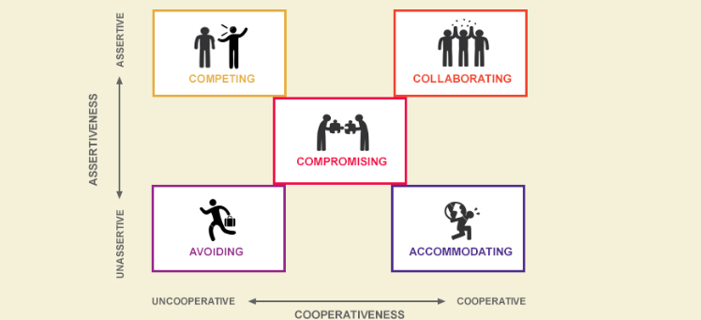
What did we learn from the Thomas-Kilmann Conflict assessment?
Notes:
Assertiveness – how much you try to satisfy your own concerns
Cooperativeness – how much you try to satisfy your teammate’s concerns
Avoiding – you sidestep the problem without satisfying either person’s concerns
Accommodating – you attempt to satisfy the other person’s concerns at the expense of your own
Compromising – you attempt to find an acceptable settlement that only partially satisfies both peoples concerns
Competing – you try to satisfy your own concerns at the other person’s expense
Collaborating – you try to find a win-win solution that completely satisfies both people’s concerns

Slide 32
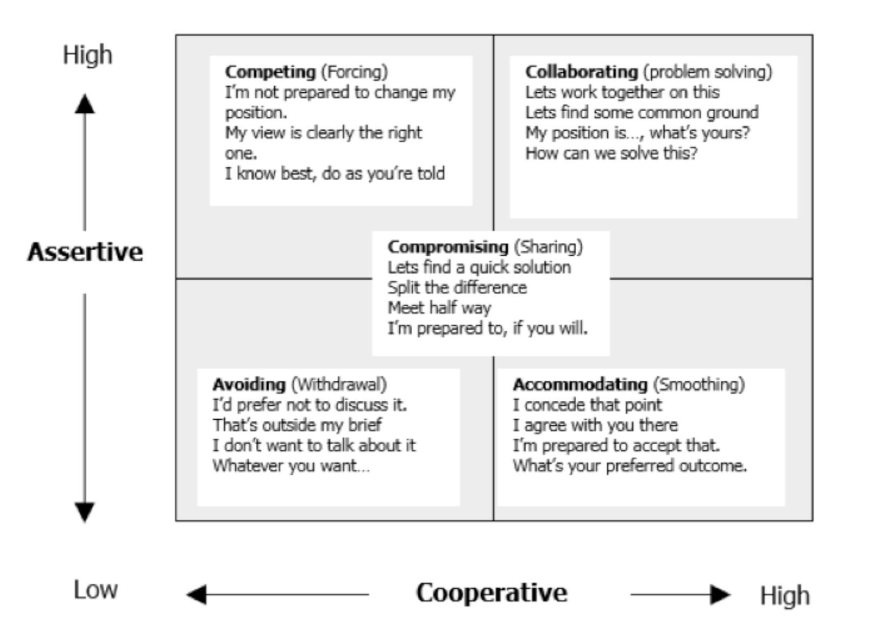
Thomas-Kilmann Conflict Styles
Ref: From Thomas-Kilmann – Conflict Mode Instrument
Notes:
The questionnaire is designed to assess your behavior in conflict situations, where a situation arises and at least two people appear to be incompatible. In such situations, we can describe a person's behavior along two basic dimensions: (1) Assertiveness, the extent to which the individual attempts to satisfy his/her own concerns, and (2) Cooperativeness, the extent to which the individual attempts to satisfy the other person's concerns. These two basic dimensions of behavior can be used to define five specific methods of dealing with conflicts, as shown on the grid above

Slide 33
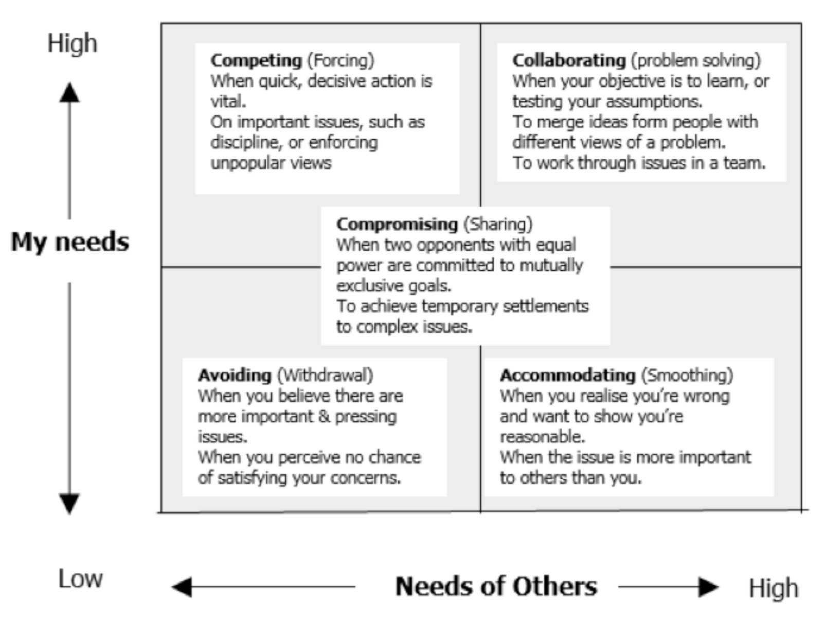
Appropriate Use of Conflict Styles
Notes:
Each of the five conflict modes has its strengths and weaknesses, depending upon the conflict situation you are in. To maximize your ability to influence and manage conflict it is important to know how to adapt your style according to the situation you find yourself in.
The chart above depicts some examples of conflict situations, and suggests the most appropriate conflict mode to use for that situation.

Slide 34
Constructive conflict dialogue
People are often so anxious about dealing with conflict that they cannot bring themselves to open a dialogue to resolve the issue.
Plan, prepare, rehearse
Adopt a constructive attitude
Assertively state the message
Stay quiet while the other party processes the message
Patiently and actively listen to the response
Restate and clarify
Focus on solutions
Notes:
People are often so anxious about dealing with conflict that they cannot bring themselves to open a dialogue to resolve the issue. This means that the issue does not get resolved and usually will get worse. When people do engage in dialogue, conflict usually reduces significantly so it is always worth the investment. Here’s how to handle a conflict dialogue constructively.

Slide 35


Avoid “fight or flight”
Substitute responses
Instinctive responses

Slide 36
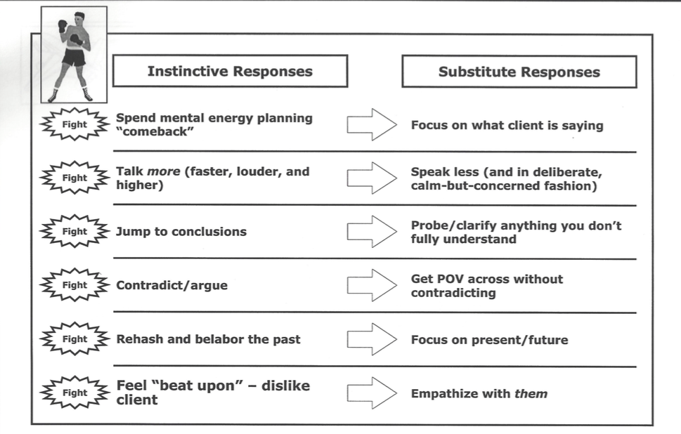

Slide 37
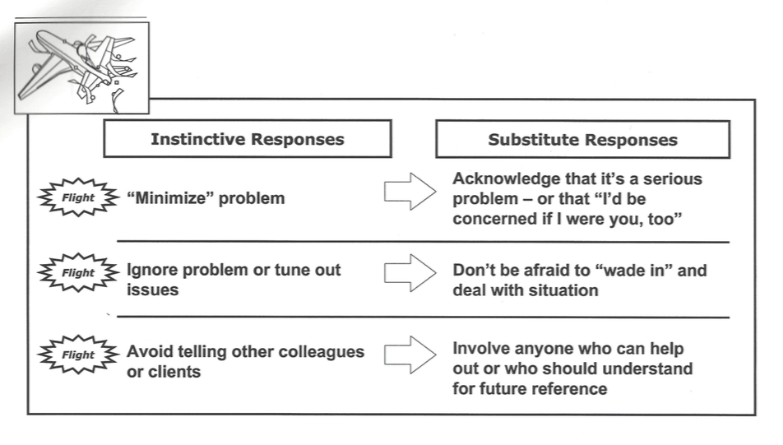

Slide 38

LOST AT SEA!

Slide 39
This week’s assignments

Slide 40
Reflect on your approach to networking. Why does networking even matter? How do you prepare? How do you genuinely factor in your “why”? What are the biggest challenges (in your opinion) and how can you overcome? For inspiration, choose from NYT’s, “How Not to Be a Networking Leech” NPR’s, “How to Make Networking Events Less Awkward,” and Forbes, “The Networking Advice No One Tells You.”
Complete your leadership playbook presentation outlines (Tuesday due: 11/4; Thursday due 11/6).

Slide 41
Quick hits on what you need to do with your outline:
The outline counts towards your final project grade and will include an overall plan for your leadership playbook presentation – you should include:
The type of leader you want to be and why
How you plan to expand your 2 assigned topics - what are the 3 sub topics for each?
What additional research will you do - whether that’s talking with leaders you know, exploring other resources to inform your points of view, etc.?
Your plan for engaging your audience - you have ~10 minutes to present - how will you use this time? What creative ideas can you incorporate to ensure a room full of students is going to want to lean in and pay attention to what you have to say?
How will you approach the work - what roles will each team member play throughout the life of this project? What specifically will you do to be accountable to one another? How will they share feedback with one another - especially constructive feedback if someone is not pulling their weight/ meeting a deadline?
Outlines are due week of 11/3 (Tuesday 11/4; Thursday 11/6), in word or PDF format, submitted on Canvas.

Slide 42
Next week’s plan

Slide 43
  We’ll continue with leadership out by:
Embracing networking

